Slide 1
BARGAIN HUNTER
ER Diagrams

Slide 2
Team2 : BARGAIN HUNTER
List of Entities
Entity Name | Entity Primary Attributes
Sell Items | HOUSEID,ITEMID,Category,Type,Description,Add Photos, Add Video, Location,Price,Phone Number, REMAIL
List Homes | HOUSEID,Category,Bedrooms, Bathroom, Agreement Type, Move In Date, Pet Friendly,Furnished,Appliances,Add photos, Add video, Location, Price, Phone Number, REMAIL
Payment Customer Subscription Customer Support Promote Ads Transactions Security Bookings | PAYMENTID, REGISTERID, Full Name, Address, City, State, Zip code, card number, expiry date,cvv,name on card CUSTOMERID, c_firstname,c_lastname,zipcode,date,city,c_email SUBSCRIPTIONID,start_date,end_date,price INQUIRIESID,live_chat,Inquiries ADID,cost,duration,status TRANSACTIONID, PAYMENTID, Payment Transactions, Transaction History, Transaction Status USERID, LOGINID,login timestamps and expiration timestamps BOOKINGID,PAYMENTID, Guest Information, Date

Slide 3
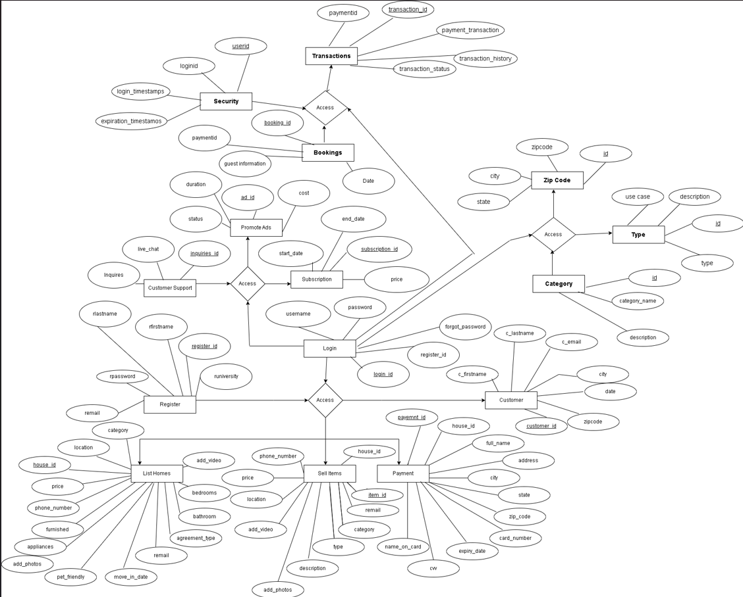
Team2 : BARGAIN HUNTER
Conceptual ER Diagram

Slide 4
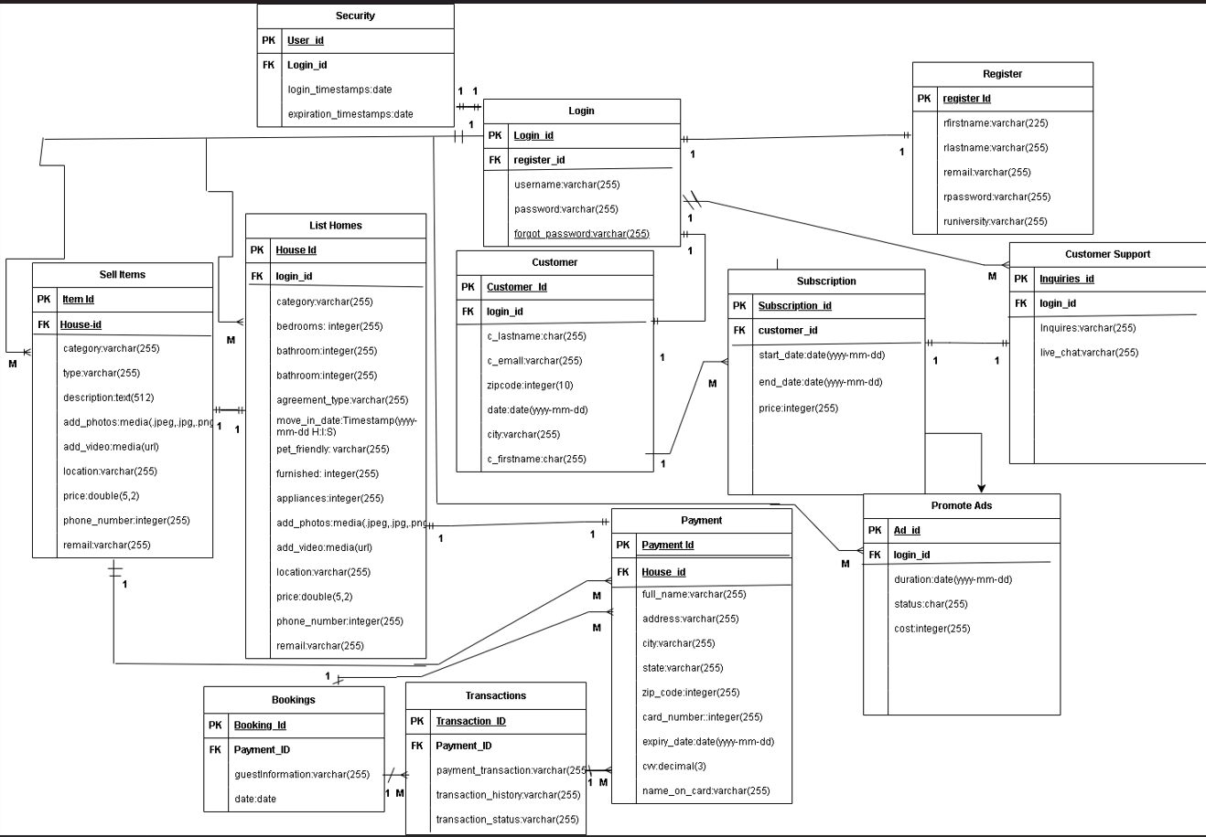
Team2 : BARGAIN HUNTER
Logical ER Diagram

